Slide 1
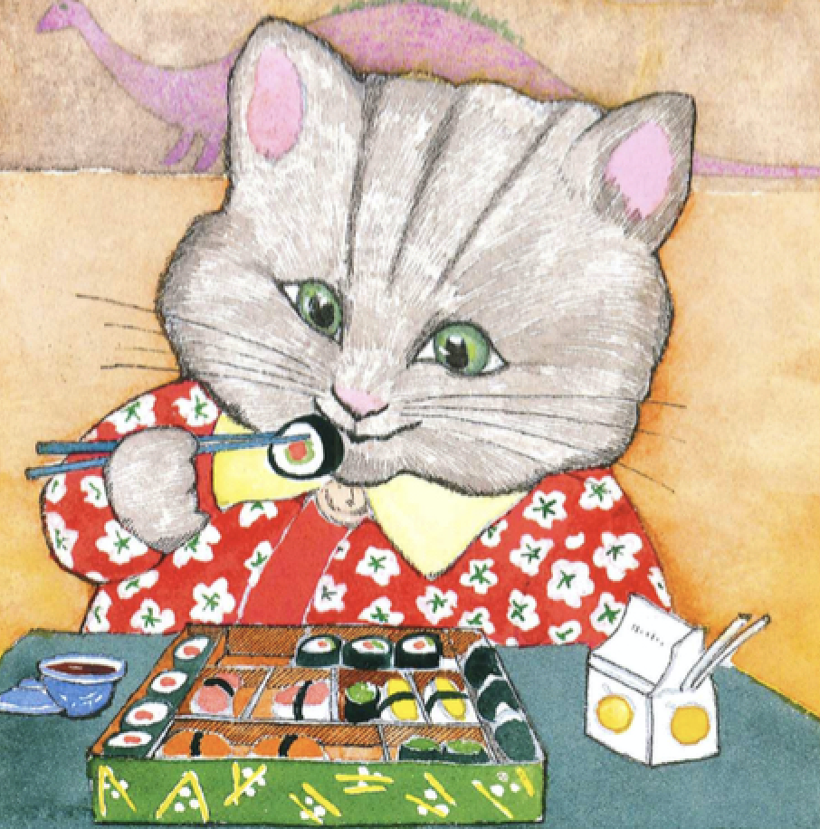
Week 3 “Young Children’s Thinking About Ethnic Differences,” Ramsay “Microaggressions and the Asian American Experience,” Sue “Confirming and Disconfirming Stereotypes,” Lee and Zhou by Wed read: The Name Jar, Choi; Yoko, Wells and Media: “Peanut Butter, Jelly and Racism,” Reshamwala
Agenda this week:
Mon: understanding the structure of stereotyping:
--categorization as a function of cognitive development
--as a function of faulty reasoning
Wed:
--why stereotypes persist
--literature as diversity pedagogy: hopes and limitations

Slide 2
Announcements:
The Psycholinguistics Lab is currently conducting a study looking into how people who know one language versus multiple languages use linguistic information.
(1) We are looking for native speakers of Spanish who are proficient in English.
(2) Online or at the Psycholinguistics Lab (Helen C. White 7103).
(3) It will take about 30 minutes to complete.
(4) You will (i) complete a short language background questionnaire and (ii) make decisions on visual and auditory stimuli presented through a computer.
(5) You will be compensated $5.00 for your time.
contact jhuynh5@wisc.edu to schedule a session, Juliet Huynh, Assistant Professor, Department of English
AND TODAY
Monday, September 18, 6-8 p.m.
MSC Lounge (249), Red Gym
APIDA (Asian Pacific Islander Desi American) Student Center
New Student Welcome
contact Kevin Wong at kevin.wong@wisc.edu.

Slide 3
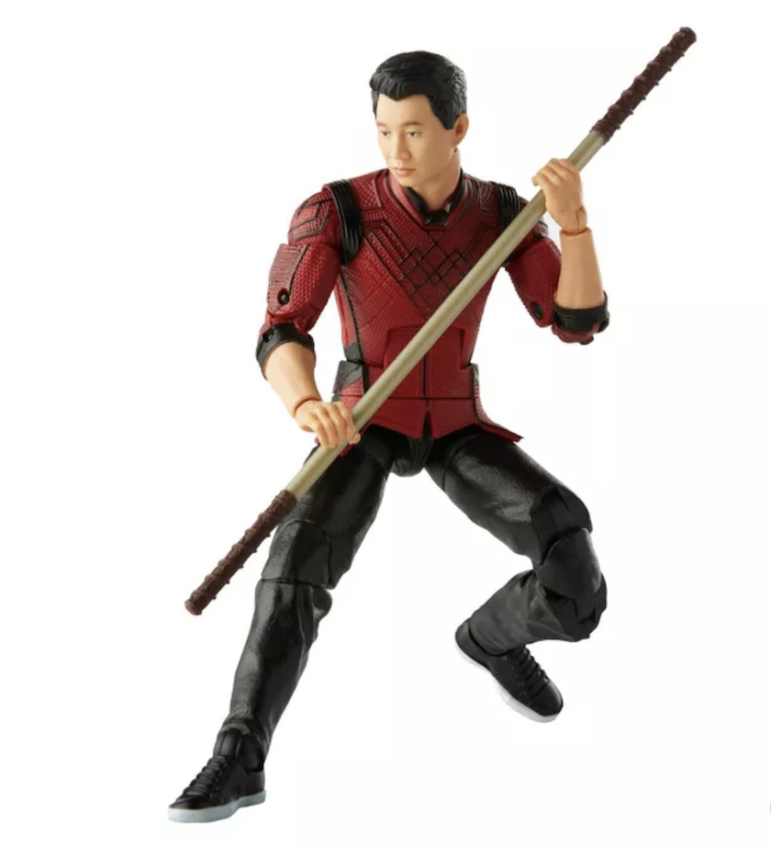
From Lee and Zhou, 123 “Symbolic Capital and Stereotype Promise”:
Definition:
“Stereotypes are widely held, oversimplified, fixed images or ideas of particular groups” (123).

Slide 4
2. Media and the power of a (racial) belief system or discourse Ono and Pham: p. 26-27
“There is no one-to-one correlation between what the media construct and what people think, of course, or even between what media producers ‘intend’ and what ends up on the screen” (26)
but
[b]ecause most dominant, mainstream media makers form their own ideas based on their subjective knowledge of and experiences with Asians and Asian Americans, powerful representations such as yellow peril . . . may help to define for the broader society who Asians and Asian Americans are” (27).

Slide 5
From “Racial Microaggressions and the Asian American Experience,” Derald Wing Sue, et. al.
“[M]icroaggressions are brief, everyday exchanges that send denigrating messages to people of color because they belong to a racial minority group” (Sue et. al p. 72).
“The ‘old fashioned’ type where racial hatred was overt, direct, and often intentional, has increasingly morphed into a contemporary form that is subtle, indirect, and often disguised. Studies on the existence of implicit stereotyping suggest that the new form of racism is most likely to be evident in well-intentioned White Americans who are unaware they hold beliefs and attitudes that are detrimental to people of color . . . The ‘new ‘ manifestation of racism has been likened to carbon monoxide, invisible, but potentially lethal” (emphasis mine, p. 72).

Slide 6
Pivot from evaluating stereotyping from the point of view of
--content (US ideas about Asian/Americans)
--accuracy (true or false)
--ethics—good images vs. bad ones; hurtful representation or “symbolic capital” (Lee and Zhou)
How might we look at stereotyping as
a cognitive process?

Slide 7
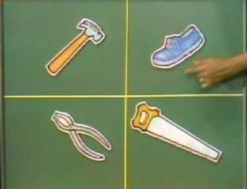
“universal” processes of categorization: “One of these things is not like the other”

Slide 8
On the processes of group categorization in the developmental psychology of children:
From “Young Children’s Thinking about Ethnic Differences,” Ramsey, p.58:
“[C]hildren were asked to select two children out of the three that ‘go together’ . . . . Groups generally were formed along visible traits such as skin color, gender, hair, and clothing. The subjects used race most frequently, gender the next most frequently, and clothing least often.”

Slide 9
How do “children acquire negative intergroup attitudes” (Katz)? [Can we really call these prejudices or biases?]
Obvious answers about society:
--parents?
--social environment: media, peers, teachers, etc.?
Less obvious theories:
--innate preference for light over dark?
--personality type—flexible vs. rigid?
--vs. Understanding race-ethnicity as a reflection of
cognitive development, capacity to understand categorization

Slide 10
On young children’s “transductive reasoning”as a function of cognitive development in “Young Children’s Thinking About Ethnic Differences,” Patricia Ramsay
Children’s group generalizations based on their experiences:
1. “Chinese people always eat in restaurants” (p. 62)
2. “brown people always fight” (p. 62)
Are these statements examples of prejudice? Are they innocent? If racial beliefs are derived from anyone’s experience, how can we counteract the illogical fallacy of these overgeneralizations?

Slide 11
From “Young Children’s Thinking About Ethnic Differences,” Ramsay, p. 62
“After one altercation with one of his two Black classmates, a 5-year-old White child told his mother that ‘brown people always fight.’
This child linked two concrete pieces of information, the fight and his opponent’s skin color, and assumed that people who are alike in one respect must be similar in all respects. He was unable to consider at that time that he also had fights with White classmates and that there was a Black child with whom he did not fight” (Ramsey, p. 62).

Slide 12
anecdote: an acquaintance’s adult memory thinking back to schooling in Los Angeles: “Black kids always tried to beat me up.”
Logic behind the statement as a form of faulty transductive reasoning:
Sammy threatened to beat me up.
Sammy is black.
Therefore, black kids always tried to beat me up.

Slide 13
from Ramsey, “Young Children Thinking about Ethnic Differences”: “brown people always fight” (p. 62) and anecdote:“Black kids always tried to beat me up.”
logic behind the statement as a form of faulty transductive reasoning:
Sammy threatened to beat me up.
Sammy is black.
Therefore, black kids always tried to beat me up.

Slide 14
A syllogism: (Greek: "conclusion, inference") is a kind of logical argument that applies deductive reasoning to arrive at a conclusion based on two or more propositions that are asserted or assumed to be true.
A. All men are mortal. Major premise
B. Socrates is a man. Minor premise
C. Therefore, Socrates is mortal. Conclusion deduced

Slide 15
A is predicated of all B
B is predicated of all C
Therefore A is predicated of all C.
false deduction or
logical fallacy politicized:
All terrorists are Muslim.
Mohammed is Muslim.
Therefore, Mohammed is a terrorist.

Slide 16
Belief: Prejudiced people are just ignorant.
Restated:
Holding prejudices about groups may reflect a developmental inability to process complex pieces of information. Like children, those who stereotypes rely upon faulty “transductive reasoning.”

Slide 17

“In their search for coherence, people often suppress individual variations to support group generalizations. This phenomenon is particularly true for children because they can focus only on one attribute at a time”
(Ramsey, “Young Children’s Thinking about Ethnic Differences,” p. 68, emphasis mine).

Slide 18
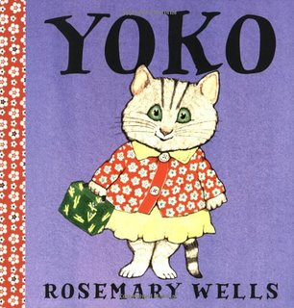
Read by Wed:
“The Name Jar,” Yansook Choi “Yoko,” Rosemary Wells
To think about:
Do you recall a moment in childhood in which you became aware of the categorizations that adults use, perhaps a moment in which you overapplied that categorization?
Would you share either of these books on the right with your (hypothetical, actual) child? Why/why not?

